Slide 1
Reliability
This section will introduce you to the distribution system reliability analysis module.

Slide 2
What is the reliability module?
Induces random events in the GridLAB-D environment
Gathers impact of the random events
Works in conjunction with the powerflow module
  Performs faults on a distribution system
  Reports indices based around the IEEE 1366-2003 standard
  Only works with Newton-Raphson solver

Slide 3
How does it work?
Monitors meters and triplex-meters (customer loads)
  All customers are treated equally
Provides “scheduled” or random faults to a distribution system
  Specified general object (e.g., overhead line)
  Specified fault (L-G, L-L, L-L-G, 3-L-G)
  Specified duration (Mean Time to Restoration)
  Specified frequency of occurrence (Mean Time To Failure)
Performs the fault, collects outage information, and collects metrics – not a detailed fault analysis tool

Slide 4
Objects in Reliability Module
object eventgen {
char1024 target_group;
char256 fault_type;
enum failure_dist;
enum restoration_dist;
double failure_dist_param_1;
double failure_dist_param_2;
double restoration_dist_param_1;
double restoration_dist_param_2;
char1024 manual_outages;
double max_outage_length[s];
int32 max_simultaneous_faults;
}
Defines fault object category
Defines fault type
Defines fault circumstances

Slide 5
Objects in Reliability Module
object metrics {
char1024 report_file;
char1024 customer_group;
object module_metrics_object;
char1024 metrics_of_interest;
double metric_interval[s];
double report_interval[s];
    }
Collects the system statistics
Requires module-specific metrics calculation object
Relates results to “customers” (meters in powerflow)
Outputs results to report_file

Slide 6
Powerflow Metrics Object
object power_metrics {
double SAIFI;
double SAIFI_int;
double SAIDI;
double SAIDI_int;
double CAIDI;
double CAIDI_int;
double ASAI;
double ASAI_int;
double MAIFI;
double MAIFI_int;
double base_time_values[s];
    }
Computes IEEE-1366-2003 metrics

Slide 7
Reliability Output
Log of events (if specified) – Fault locations and timing
IEEE 1366-2003 Metrics
  SAIDI – System Average Interruption Duration Index
  SAIFI – System Average Interruption Frequency Index
  CAIDI – Customer Average Interruption Duration Index
  ASAI – Average Service Availability Index
  MAIFI – Momentary Average Interruption Frequency Index
Two underlying event types
  Momentary – less than 5 minutes
  Sustained – greater than 5 minutes

Slide 8

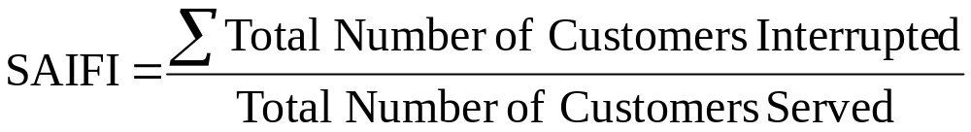
Reliability Output Explained
SAIDI – Total interrupt duration for average customer during defined time
SAIFI – Frequency average customer experiences a sustained interruption

Slide 9
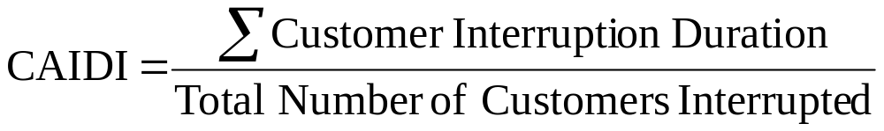
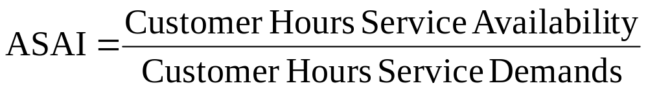
Reliability Output Explained
CAIDI – Average time required to restore service
ASAI – Average fraction/percentage of time that a customer received power

Slide 10
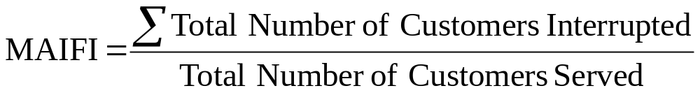
Reliability Output Explained
MAIFI – Frequency average customer experiences a momentary interruption

Slide 11
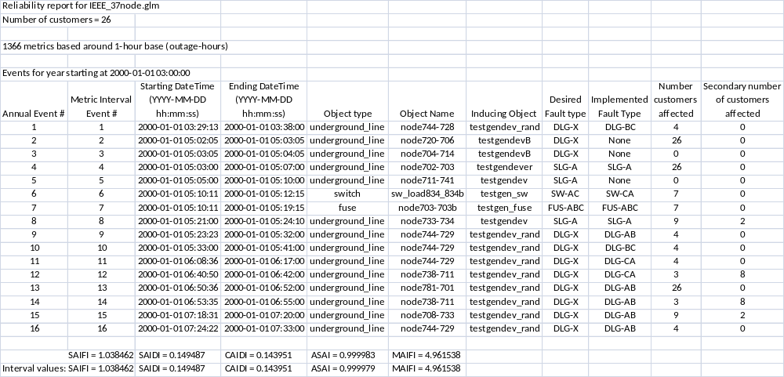
Sample Reliability Output

Slide 12
Exercise 4.2.1
IEEE_37_Node_Reliability.png shows
1-line diagram of the modified system
Exercises
  Run the IEEE 37-node test feeder with reliability events included – examine the output files
  Adjust the existing eventgen objects, or create a new one to induce a fault on the underground line “node710-735” – examine the impacts on the IEEE 1366-2003 metrics

